Slide 1
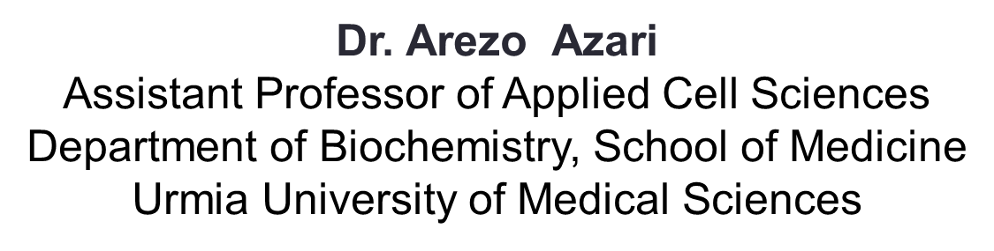
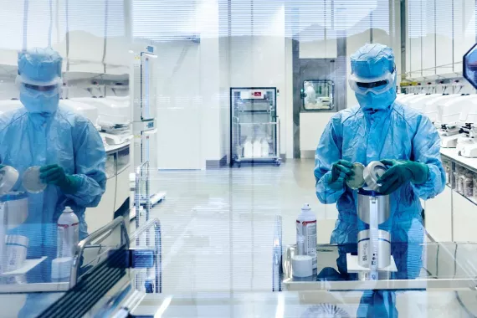
Types of cell therapy for Wound Healing

Slide 2
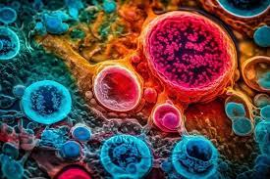
Titles
Objectives
Introduction
Main Discussion
Importance of the Issue
Conclusion
References

Slide 3
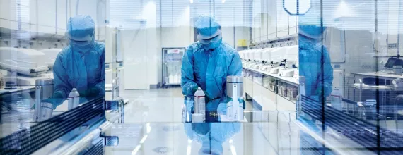
Objectives
Cell therapy
Cell therapy strategies
Target diseases of cell therapy
Types of Cell Therapy for Wound Healing
How Cell Therapy Works
Potential Benefits of Cell Therapy
Challenges and Future Directions
Cell-Based Therapy for Wounds
Types of stem cells used in wounds
Examples of the use of cells in wounds

Slide 4
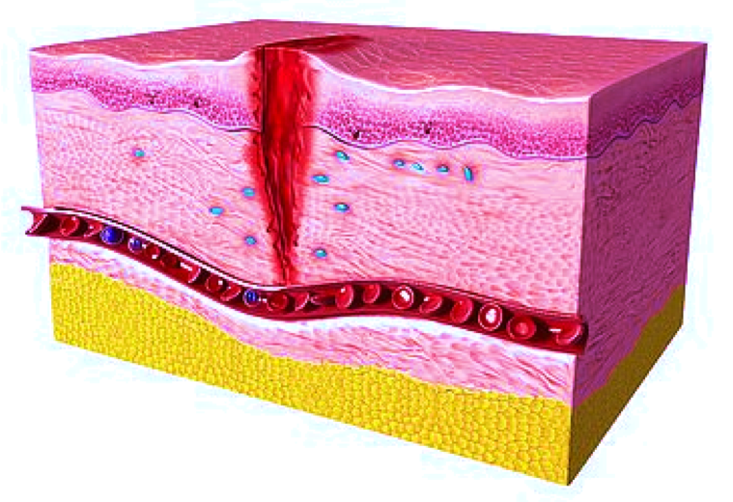
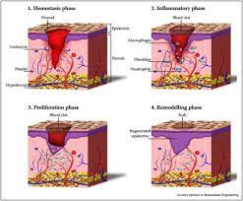
Introduction
Wounds are a growing clinical burden on healthcare systems and with an aging population as well as increasing incidences of obesity and diabetes, this problem is set to increase. Cell therapies may be the solution.
A range of cell based approaches have begun to cross the rift from bench to bedside and the supporting data suggests.
This review examines the main cell types explored for cutaneous wound healing with a focus on clinical use.
The literature overwhelmingly suggests that cell therapies can help to heal cutaneous wounds when used appropriately but we are at risk of clinical use outpacing the evidence.

Slide 5
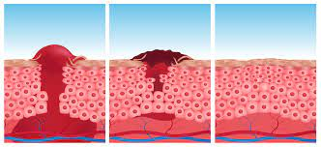
There is a need, now more than ever, for standardised methods of cell characterisation and delivery, as well as randomised clinical trials.
Cell therapy is the transfer of a specific cell type, or types, into a person to treat or prevent a disease. Many cell types have the potential to be modified and used as a therapy. Common disorders treated with cellular therapies include cancers of the blood and bone marrow, cancers of the lymphatic system, plasma cell disorders, and other conditions that affect the body’s ability to make healthy cells.
Cell therapy refers to the transfer of autologous or allogeneic cellular material into a patient for medical purposes.

Slide 6
Compared with a variety of conventional methods, such as skin grafts and local flaps, the cell therapy technique is simple, less time-consuming, and reduces the surgical burden for patients in the repair of acute wounds.
Cell therapy has also been developed for chronic wound healing. By transplanting cells with an excellent wound healing capacity profile to chronic wounds, in which wound healing cannot be achieved successfully, attempts are made to convert the wound bed into the environment where maximum wound healing can be achieved.
Fibroblasts, keratinocytes, adipose-derived stromal vascular fraction cells, bone marrow stem cells, and platelets have been used for wound healing in clinical practice. Some formulations are commercially available. To establish the cell therapy as a standard treatment, however, further research is needed.

Slide 7
WHAT DISEASES ARE TARGET OF CELL THERAPY?
Cell therapy can be used for the treatment of various types of skin defects including trauma, burn wounds, scar excision, leg ulcer, donor sites of split-thickness skin, and excision of skin tumor.
In particular, cell therapy can be useful for elderly patients in whom skin grafting or flap coverage can be a burden due to surgical procedures or patients who do not want to undergo major surgery.
In addition, this method can be a good option in covering defects involving the face and upper extremities, in which efforts should include choosing the safest and least invasive method with a goal of achieving optimal functional and cosmetic outcomes.
Cell therapy can be also effective in the treatments of chronic wounds including diabetic ulcers. In cases of chronic wounds, wound healing cannot often be achieved successfully because of the involvement of multiple factors.

Slide 8
Types of Cell Therapy for Wound Healing
Mesenchymal Stem Cells (MSCs)
Adipose-Derived Stem Cells (ASCs)
Stem Cell-Derived Extracellular Vesicles (SC-EVs) Hematopoietic Stem Cells (HSCs)
Other Cell Types:
Various other cell types, such as skin cells (keratinocytes and fibroblasts), muscle cells, and immune cells, may also be used in cell therapy for wound healing depending on the specific needs of the wound.

Slide 9
How Cell Therapy Works:
Cell therapies for wound healing can work through several mechanisms:
Direct Cell Replacement
In some cases, transplanted cells can differentiate and replace damaged or lost tissue.
Paracrine Signaling
Cells can secrete growth factors, cytokines, and other signaling molecules that promote cell proliferation, migration, and angiogenesis.
Immunomodulation
Cells can modulate the immune response, reducing inflammation and promoting a healing environment.

Slide 10
Potential Benefits of Cell Therapy
Faster Wound Healing:
Cell therapy can accelerate the healing process, potentially reducing healing time and the risk of complications.
Improved Wound Closure:
Cell therapy can promote complete wound closure, even in chronic or difficult-to-heal wounds.
Reduced Scarring:
Cell therapy may help minimize scarring and improve the cosmetic outcome of wound healing.
Reduced Infection Risk:
By promoting healing, cell therapy may indirectly reduce the risk of infection.

Slide 11
Challenges and Future Directions
Cell Source and Availability:
Finding suitable and readily available cell sources for cell therapy can be a challenge.
Cell Delivery and Retention:
Ensuring that cells are effectively delivered to the wound site and remain viable is crucial.
Immunogenicity:
There is a risk of immune rejection when using cells from a donor.
Long-term Outcomes:
Further research is needed to fully understand the long-term efficacy and safety of cell therapy for wound healing.

Slide 12
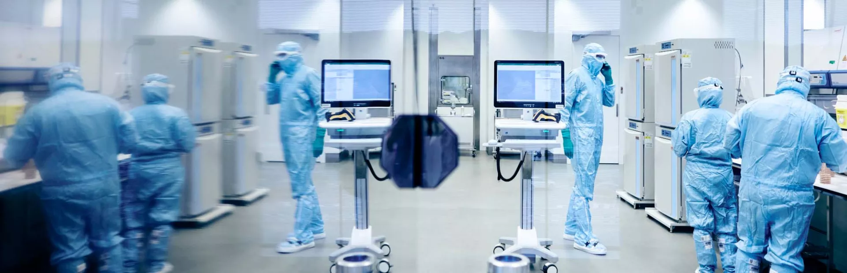
Cell-Based Therapy for Wounds

Slide 13
Types of stem cells used in wounds
Embryonic Stem Cells
Induced Pluripotent Stem Cells
Mesenchymal stem cells
Adipose-Derived Stem Cells
Hematopoietic stem cells

Slide 14
Examples of the use of cells in wounds
1- Keratinocytes (Fig. 1)
2- Fibroblasts (Fig. 2, 3)
3- Adipose-derived SVF cells ( Fig. 4 and 5)
4- Bone marrow stromal stem cells(Fig. 6)
5- Platelets (Fig. 7)

Slide 15
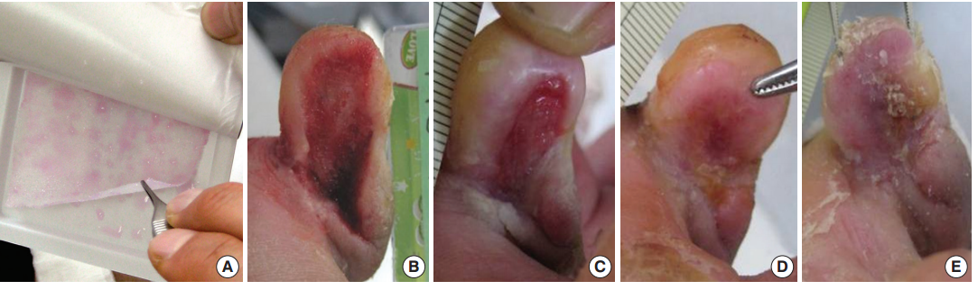
Fig. 1. Treatment of a diabetic foot ulcer using an allogeneic keratinocyte sheet. A woman (aged 63 yr) with a chronic non-healing diabetic ulcer over 10 weeks old on the medial side of the right fith toe. After debridement, freshly bleeding wound bed was prepared. (A) View of the cultured allogeneic keratinocyte sheet. (B) Preoperative view. (C-E) Wound appearance was taken every week. Re-epithelization occurred progressively from the periphery to the center of the wound. The wound was completely healed after 3 weeks.

Slide 16
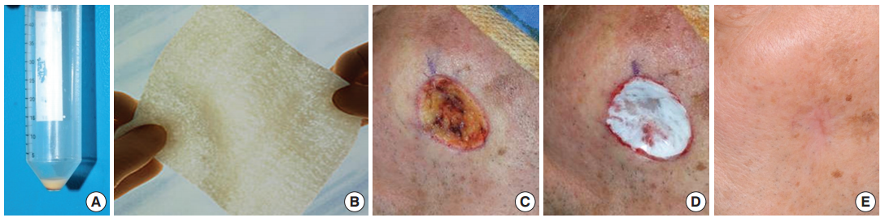
Fig. 2. Cheek defect created by removal of a basal cell carcinoma was reconstructed by autologous firoblasts seeded on a hyaluronic acid sheet. The entire wound re-epithelialized 21 days after grafting. (A and B) Fibroblast pellet and non-woven hyaluronic acid sheet. (C) After wide excision of the tumor. (D) Immediately after the graft of the tissueengineered dermis. (E) One-year after the graft. The result demonstrates excellent color match with minimal scar contracture.

Slide 17
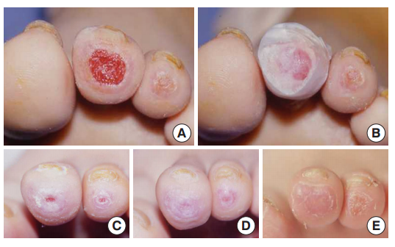
Fig. 3. A woman (aged 50 yr) with 6 week old chronic non-healing diabetic ulcers on
the left second and third toe tips. The second toe with the larger wound was treated
with the firoblast allograft, and the third toe with the smaller wound was conservatively treated. (A) Preoperative view. (B) Immediate after treatments. (C) Two weeks after treatments. (D) Twenty days after treatments, the second toe wound completely epithelized, but the third toe wound (control) had a raw surface. (E) Three months after treatments, the second toe was good with a healthy texture, but the third toe had not yet completely epithelized.

Slide 18
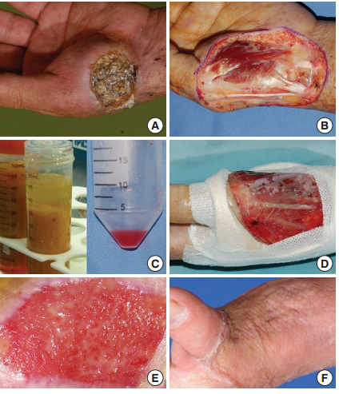
Fig. 4. Reconstruction using stromal vascular fraction (SVF) cells. (A) A squamous
cell carcinoma on the hand. (B) After wide excision of the tumor, flp surgery was required since the fist metacarpal bone and tendons were exposed. However, a procedure which needs a general anesthesia or a long operation time could not be performed due to the poor general health condition of the patient. (C and D) To prepare the wound bed to be allowed for a skin graft, stromal vascular cells were isolated and grafted on the wound bed. (E) Three weeks after the graft, a healthy granulation tissue was formed. (F) The wound was fially closed by a split-thickness skin graft under local anesthesia.

Slide 19
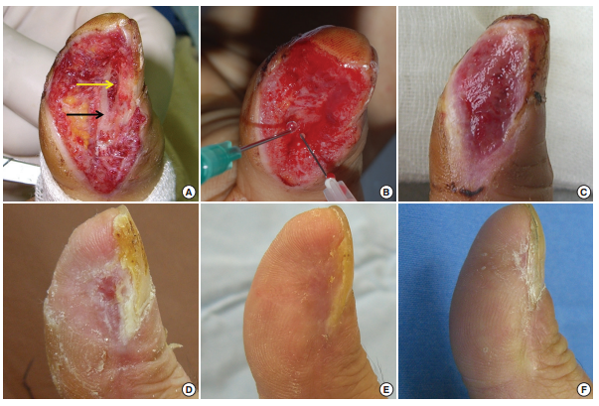
Fig. 5. Results of a stromal vascular fraction (SVF) cell graft applied to a thumb. (A) A bone and pulp defect on the thumb caused by trauma. Black and yellow arrows indicate
the cortex and medulla of the distal phalanx, respectively. (B) SVF cells suspended in firin glue were transplanted one day after trauma. (C-F) Two-weeks, 4-weeks, 3-months, and 1-yr after the graft. The wound was completely closed 4 weeks after the graft.

Slide 20
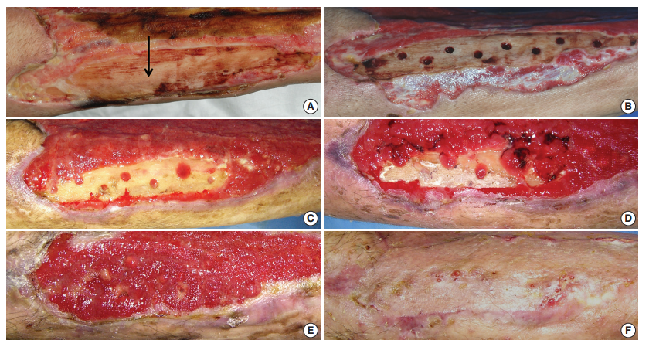
Fig. 6. A 73-yr-old man with diabetes mellitus had a non-healing ulcer over 8 weeks old on the anterior tibial area of the lower leg. (A) A large wound on the lower leg with exposed tibial bone (an arrow). (B) Drilling in the bone to take out bone marrow stromal stem cells (BSCs). (C-E) Two, 3, and 4 weeks after drilling. Granulation tissue was formed from the drilling sites. (F) The wound was closed by a skin graft.

Slide 21
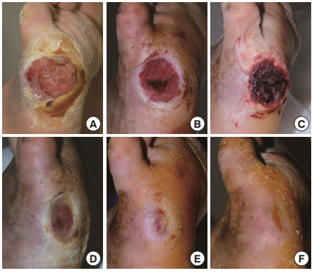
Fig. 7. A 67-yr-old man with diabetes mellitus had a non-healing ulcer on the lateral border of his right foot at the metatarsophalangeal joint level. Before participating in the study, the patient had been treated for 12 weeks. (A) Preoperative view. (B) After surgical debridement, the metatarsal and proximal phalangeal bones were exposed. (C) Three days after the fist application of blood bank platelet concentrate (BBPC) (immediate before the second application of the BBPC). (D) Three weeks after the fist application of BBPC. (E) Five weeks after the fist application of BBPC. (F) Seven weeks after treatment, the wound was completely epithelialized. Two applications
were performed for this patient.

Slide 22
Challenges
Risks
Informed consent.
Immune responses.
Organ toxicities.
Matched donors.
Accuracy required.
Immune suppression.

Slide 23
CONCLUSION
Cell therapy is an expanding global market encompassing stem
cell- and non–stem cell-based unicellular and multicellular
Cell therapy is an expanding global market encompassing stem cell- and non–stem cell-based unicellular and multicellular therapies, which largely differ in their characteristics, isolation sources, and areas of use.
Limited clinical indications, high production cost, and high patient costs are other issues associated with cell therapies that need to be addressed by ongoing and future clinical trials .
It is evident that stem cells have a tremendous potential for cutaneous tissue regeneration, as these cells not only can regenerate lost tissue but also promote wound repair through paracrine manner. Several cell types, such as embryonic stem cells, iPSCs, mesenchymal stem cells, resident tissue stem cells, epithelial stem cells, adipose-derived stem cells, and hematopoietic stem cells, are currently under intense investigation.

Slide 24
Reference
Principles of Regenerative Medicine
Stem Cell Biology
Essentials of Stem Cell Biology
1. Kim I. A brief overview of cell therapy and its product. J Korean
Assoc Oral Maxillofac Surg. (2013) 39:201. doi: 10.5125/jkaoms.2013.
39.5.201
2. American Society of Gene and Cell Therapy. Gene & Cell Therapy FAQs.
(2021). Available online at: https://asgct.org/education/more-resources/
gene-and-cell-therapy-faqs (accessed April 24, 2021).
3. Lefrère JJ, Berche P. La thérapeutique du docteur Brown-Séquard. Ann
Endocrinol. (2010) 71:69–75. doi: 10.1016/j.ando.2010.01.00
4. You, H. J., & Han, S. K. (2024). Cell therapy for wound healing. Journal of Korean medical science, 29(3), 311.‏
5. Hong, C., Lee, Y., Chung, H., Kim, D., Kim, J., Kim, J. W., ... & Kim, S. H. (2025). Micro-fragmented collagen hydrogel wound dressing: Enhanced porosity facilitates elevated stem cell survival and paracrine effects for accelerated wound maturation. Materials Today Bio, 32, 101678.‏

Slide 25

با تشکر از توجه شما

